Slide 1
Object-Oriented Programming (OOP) in Python

Slide 2
Object-Oriented Programming(OOP)
OOP is a programming paradigm that allows us to structure programs in a way that properties (or attributes) and behaviours of real things are combined into separated objects. In other words, real objects are modelled as program objects.
OOP follows a procedural approach: it provides a set of steps in the form of functions and blocks of code that are executed sequentially to complete the task.
Example: An object can represent a person with a name, age, address, height, etc. the behaviours of that person could be walking, talking and running.

Slide 3
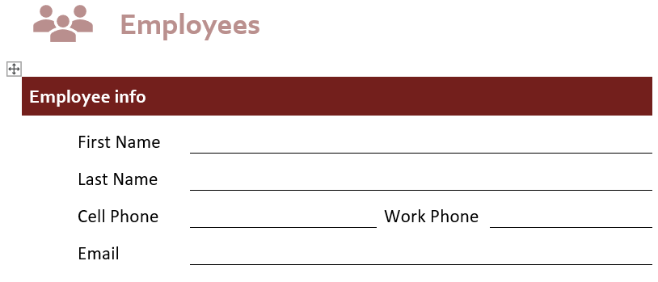
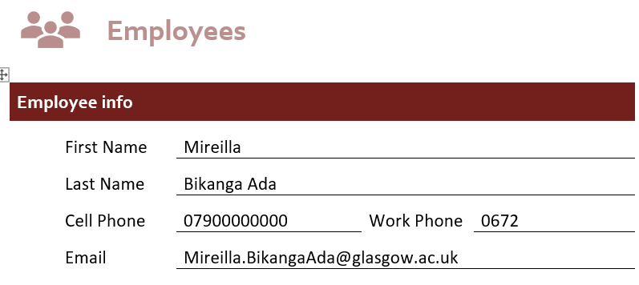
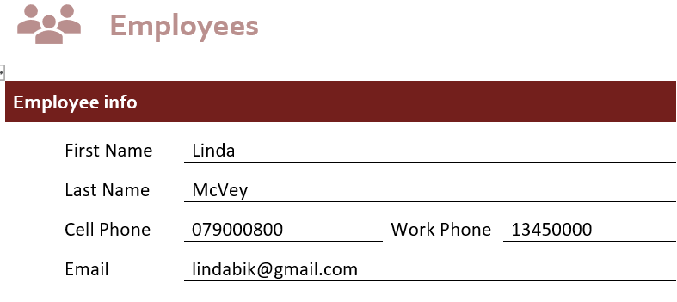
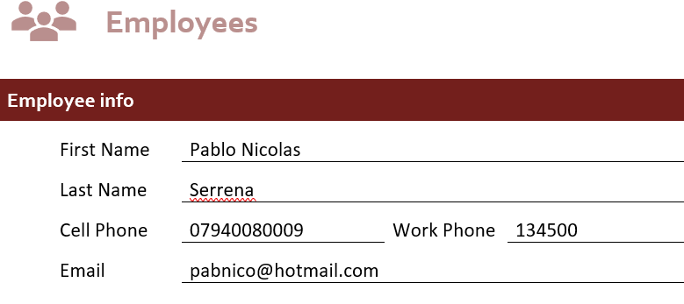
Python Classes and objects (Instances)
A class is a program template (or blueprint) that allows us to create objects.
The keyword class is used to create a class.
For example we could create a Employees() class that will indicate that the name and other details that are required.
A class does not tell us what the name or other details are. It is an abstract concept. A class helps organise information. We can think of a class as an empty form.
An instance is a copy of a class with actual values, it is an object that belong to a particular class . Many copies can be created. But we need the class (form) to know what information is required. Creating an object of a class is called instantiation.

Slide 4
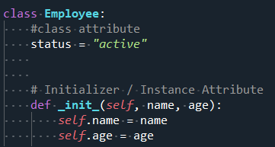
Instance Attribute & Class Attribute
Class create objects. All objects contains characteristics called attributes (properties).
The init () method initialises (creates) the attributes of an object by giving it a default value (state).
The init () method should have at least one argument and a self variable. The self variable refers to the object itself (e.g Employees)
Constructor is a method that is called by default whenever you create an object from a class.
Although each employee has a unique name and age, each employee will be active (currently employed)
Instance attributes are specific to each object.
Class attributes are the same for ALL instances.

Slide 5
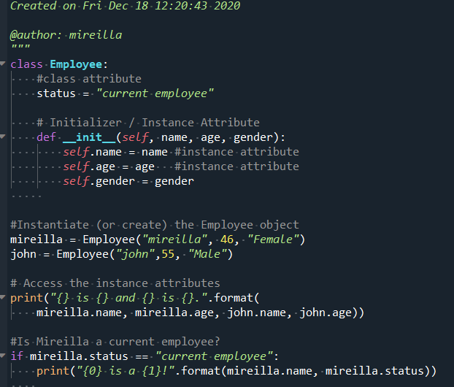

Class Employee

Slide 6
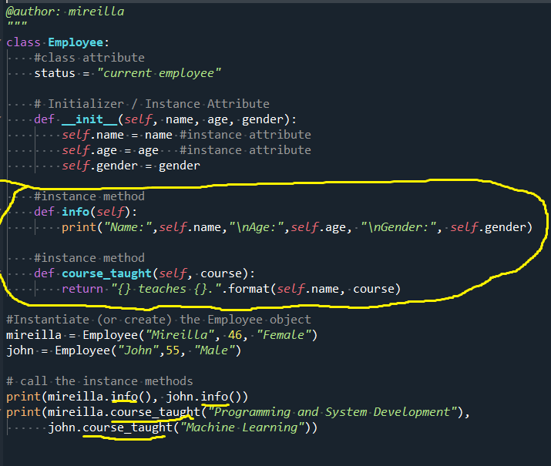
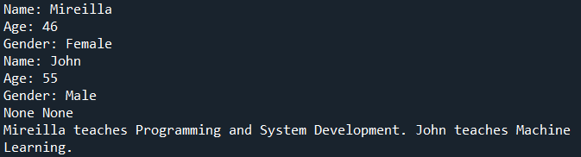
Instance Methods
Instance methods, defined inside the class, are used to get content of the instance and perform operations with the attribute of our objects.

Slide 7
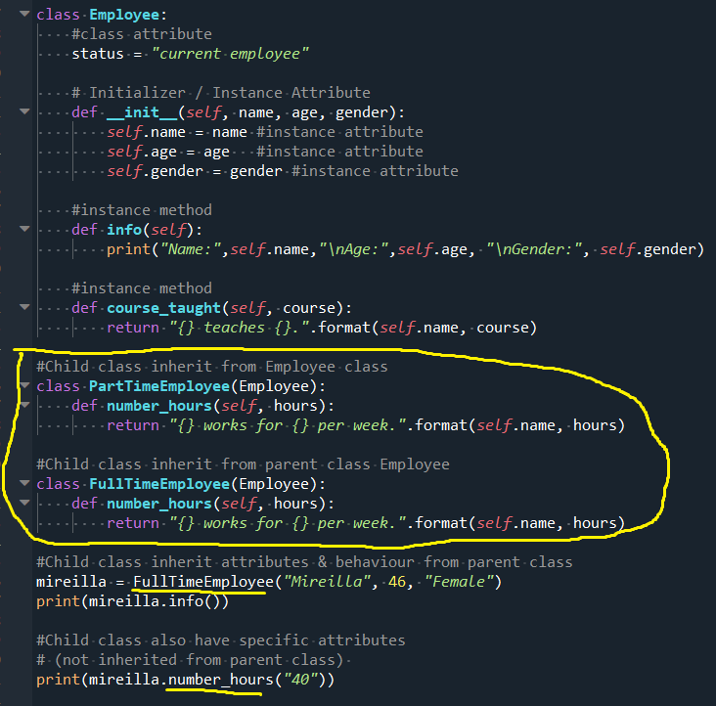
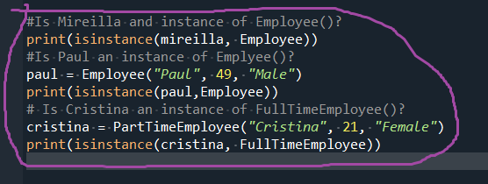

Python Object Inheritance
Inheritance is when one class accepts the attributes and methods of another class. It helps prevent code duplication.
Child class: newly created class.
Parent class: a class from which a child class derives.
Child class overrides or extends functionalities: It will take (inherit) all the attributes and behaviour of a parent class and can define further behaviours.
To determine if the instance is an instance of a specific parent class, use isinstance()

